Slide 1
Fantasy Premium League
Link : https://www.kaggle.com/datasets/ritviyer/fantasy-premier-league-dataset
Research Purpose:
I have choosen this dataset to know how each player is ranked and is auctioned based on which feilds and whether that player can play the coming match and which player we can select for our FPL game.

Slide 2
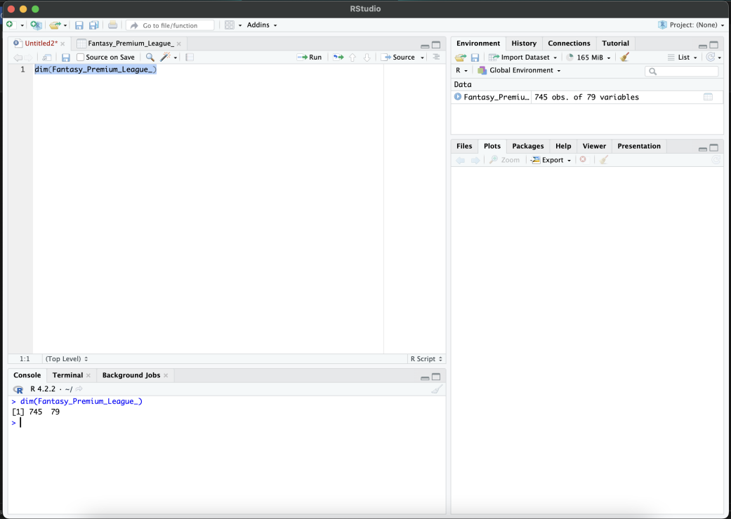
The main fields I choosed from the Dataset are : 1) Position 2) Rank 3)Expected Goals 4) Goals Scored 5) Penalties

Slide 3
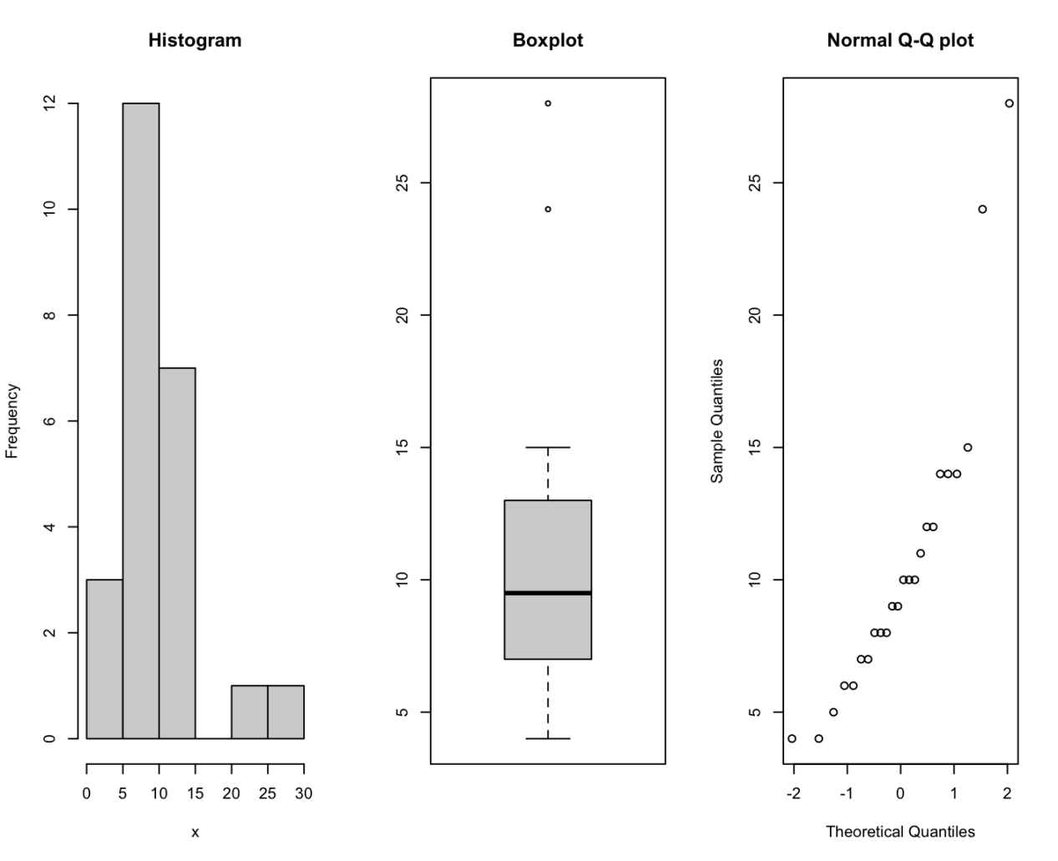
Outliers

Slide 4
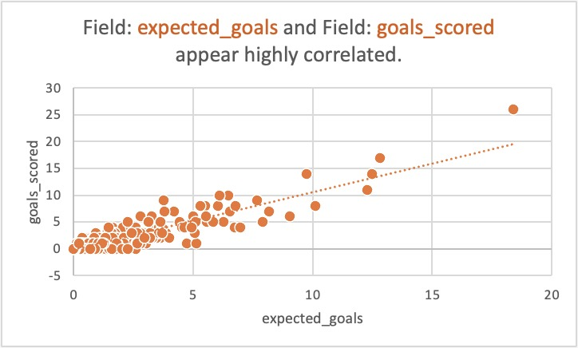
Correlation Between expected goals and goals scored

Slide 5
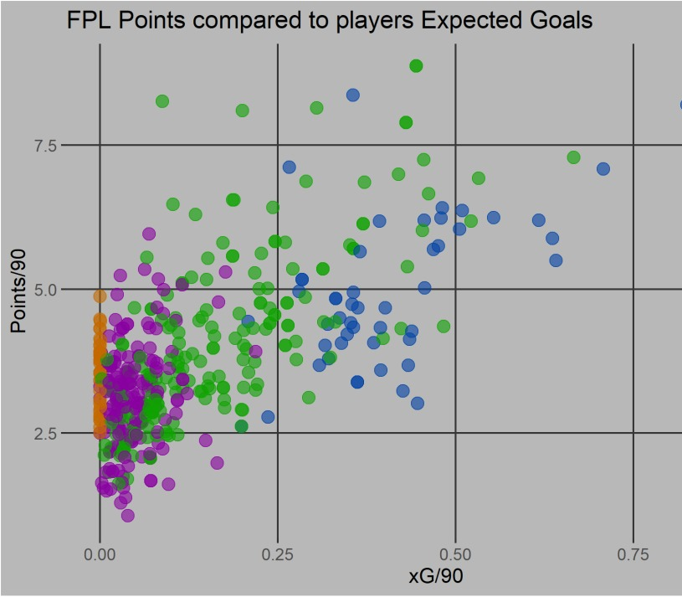
Scatter Plot

Slide 6
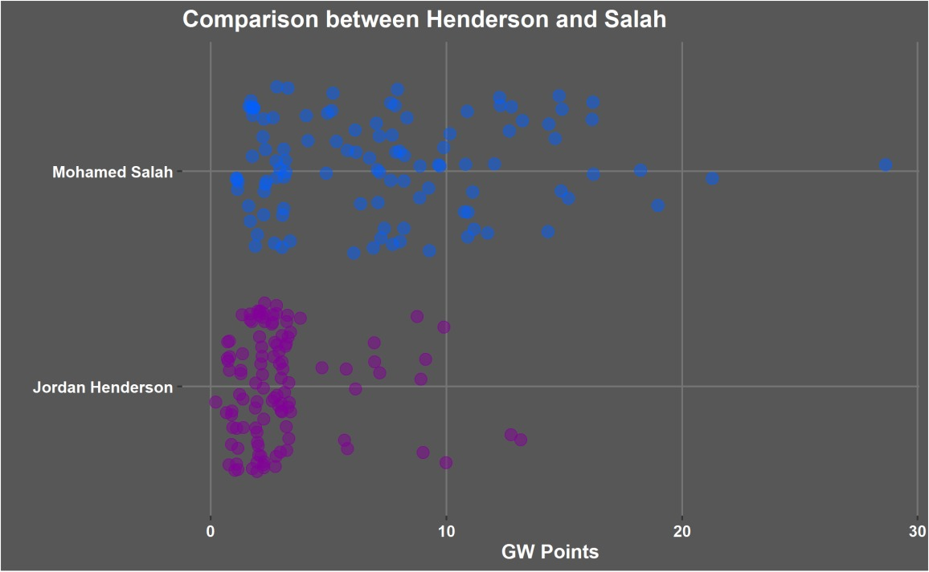
Using the same data set I created the comparison between 2 players in the same team

Slide 7
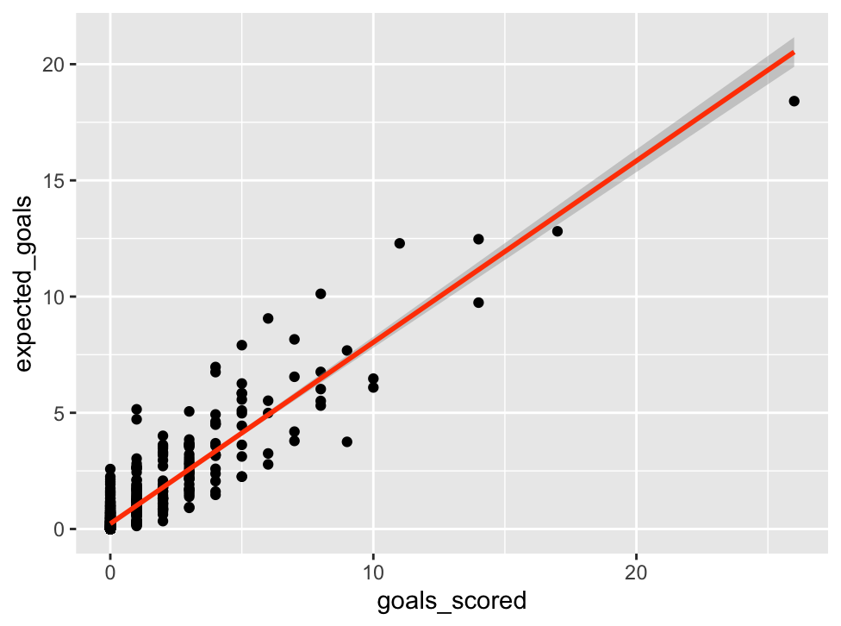
Linear Regression Model

Slide 8
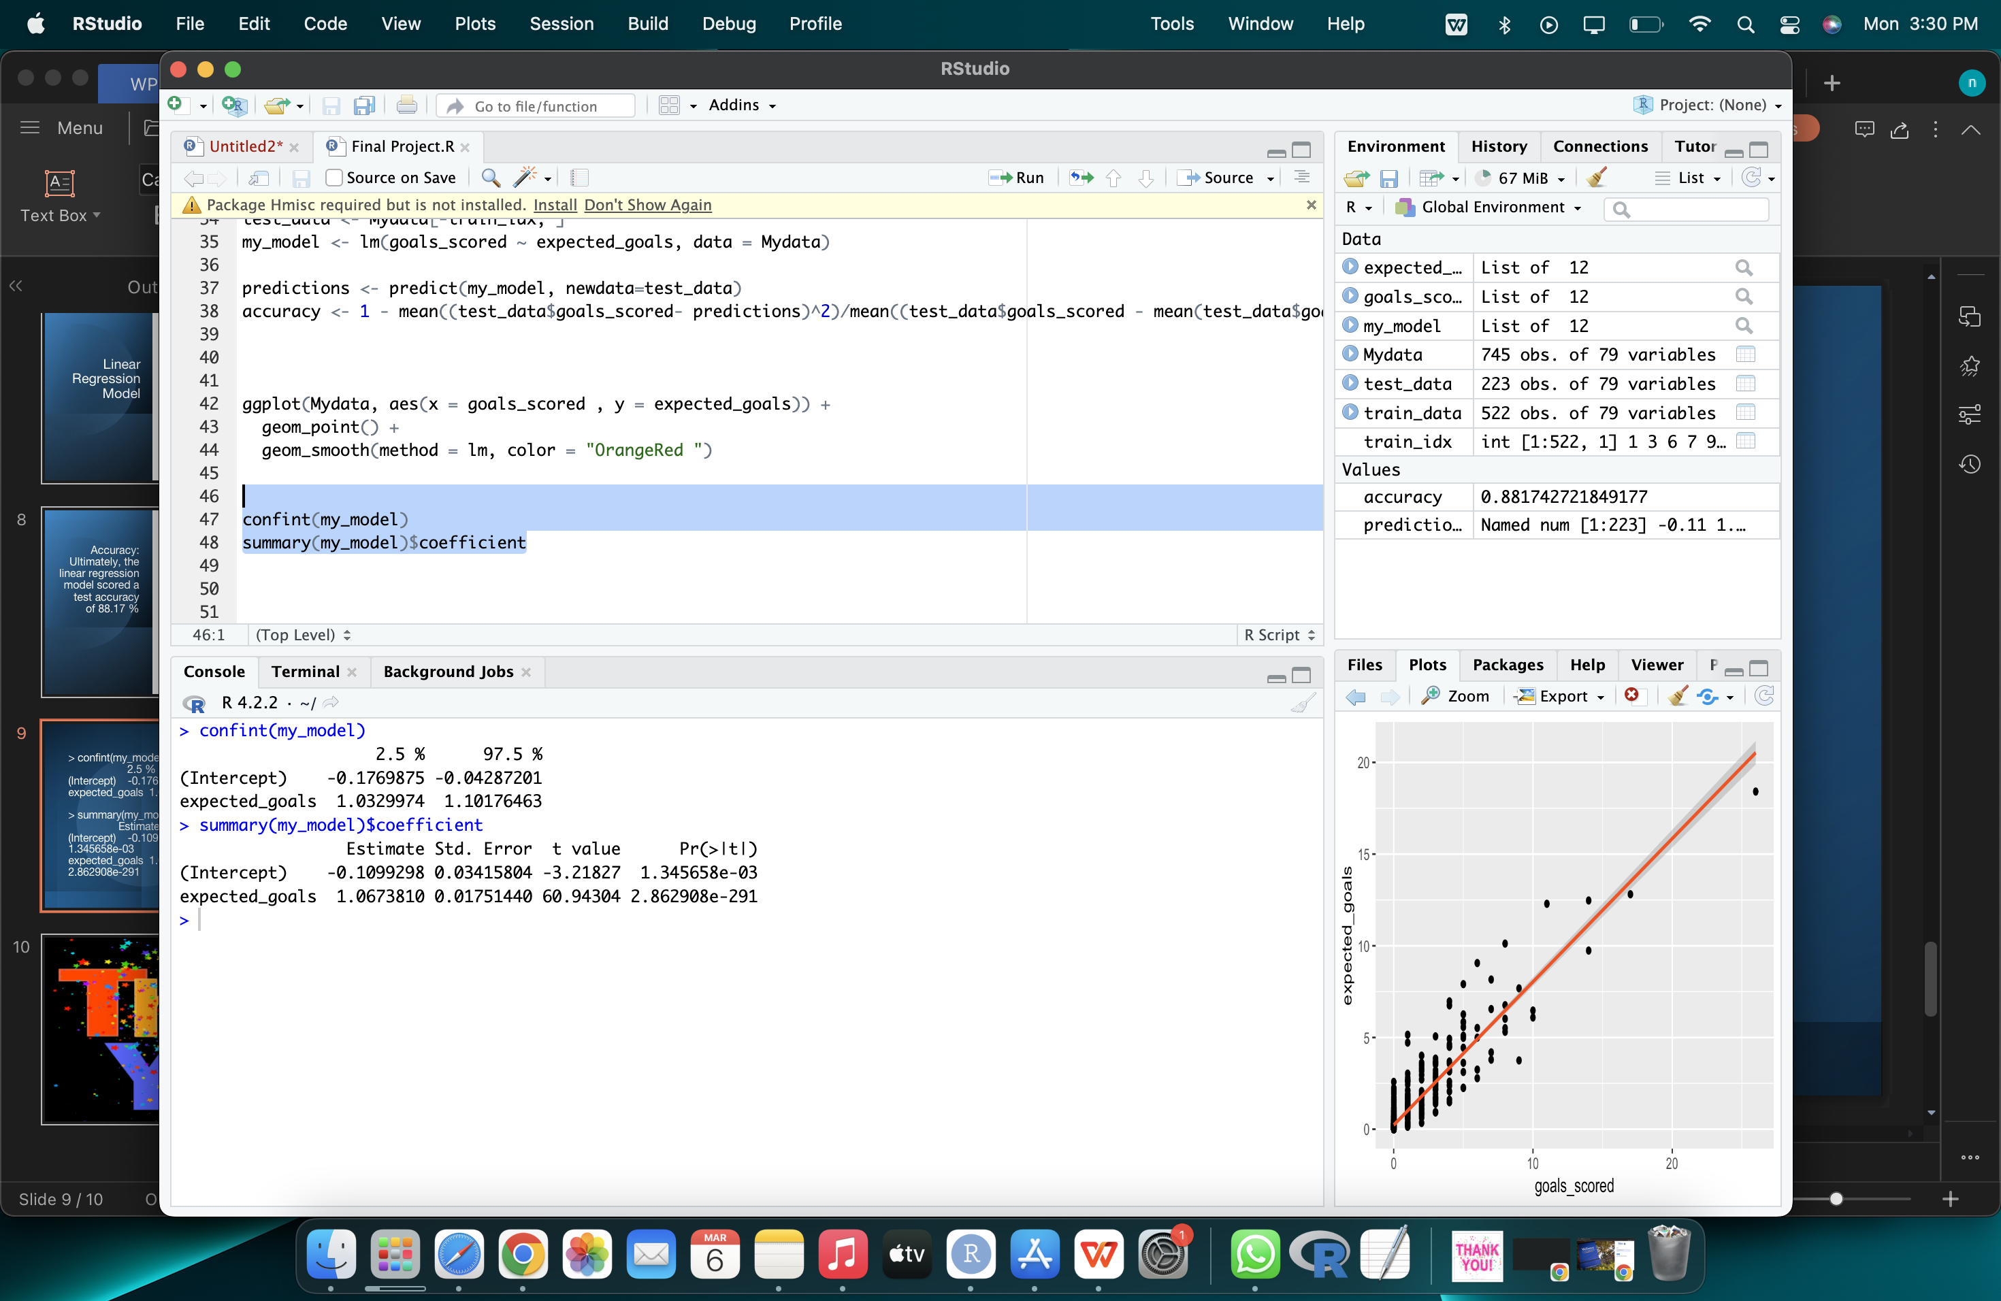

Slide 9
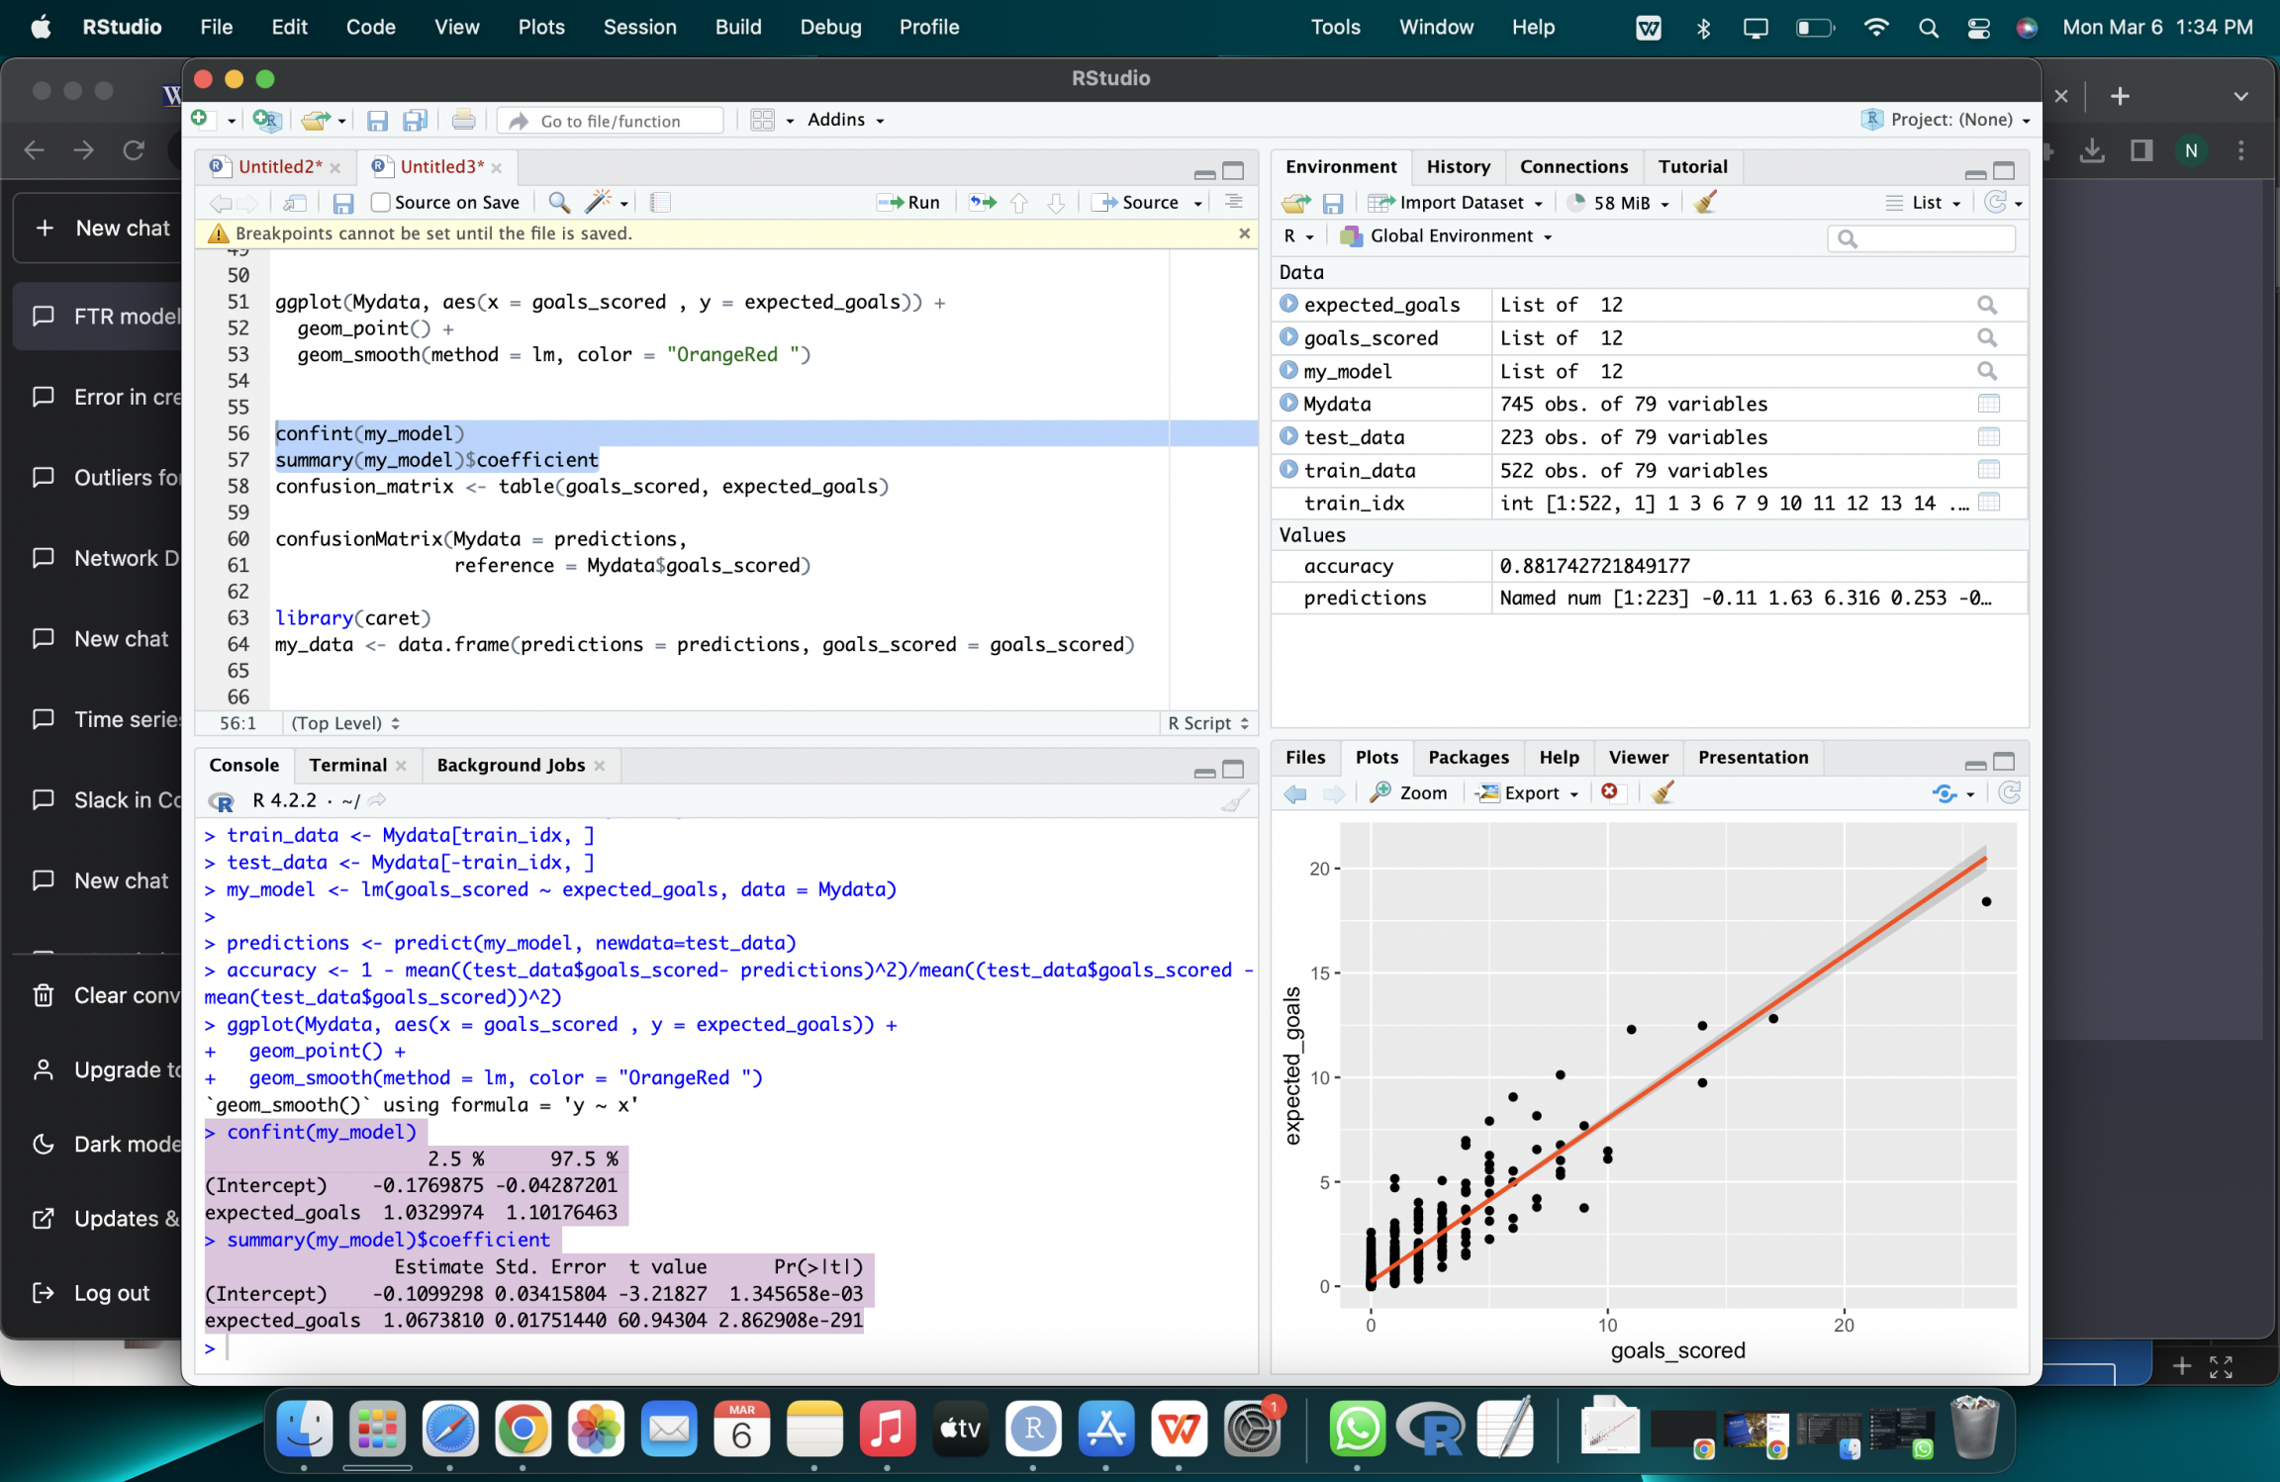
Accuracy: Ultimately, the linear regression model scored a test accuracy of 88.17 %

Slide 10


